Slide 1
AMI MATLAB GROUP 4
PRESENTATION

Slide 2
NAME | REG NO | COURSE
NAKANWAGI CATHERINE | BU/UG/2025/4412 | AMI
AYEBALE LAMEX | BU/UG/2025/4410 | AMI
ATUHAIRWE DEOGRATIUS | BU/UG/2025/4409 | AMI
WEMBABAZI IVAN | BU/UG/2025/4414 | AMI
NSAMBA GODWIN | BU/UP/2025/1960 | AMI
WAMUWAYA SULAIMAN | BU/UP/2025/2146 | AMI

Slide 3
Numerical Methods using FOR and WHILE Loops
f(x)
→ 0
Newton-Raphson · Secant · Runge-Kutta
Flowcharts, pseudo code and MATLAB code

Slide 4
OVERVIEW
Three methods, two loop styles
1
2
3
Newton-Raphson
Secant
Runge-Kutta (RK4)
Root finding using the derivative
Root finding without a derivative
Solving a first-order ODE
f(x) = x³ − 2x − 5
f(x) = cos(x) − x
dy/dx = x + y, y(0) = 1
Each method is written with a for loop and a while loop, with a flowchart, pseudo code, MATLAB code and output.

Slide 5
METHOD 1
Newton-Raphson Method
PROBLEM
Find the real root of
f(x) = x³ − 2x − 5
Initial guess x0 = 2, tolerance 10⁻⁶
FORMULA
x(n+1) = x(n) − f(x(n)) / f′(x(n))
where f′(x) = 3x² − 2
2.094551
root found in 4 iterations

Slide 6
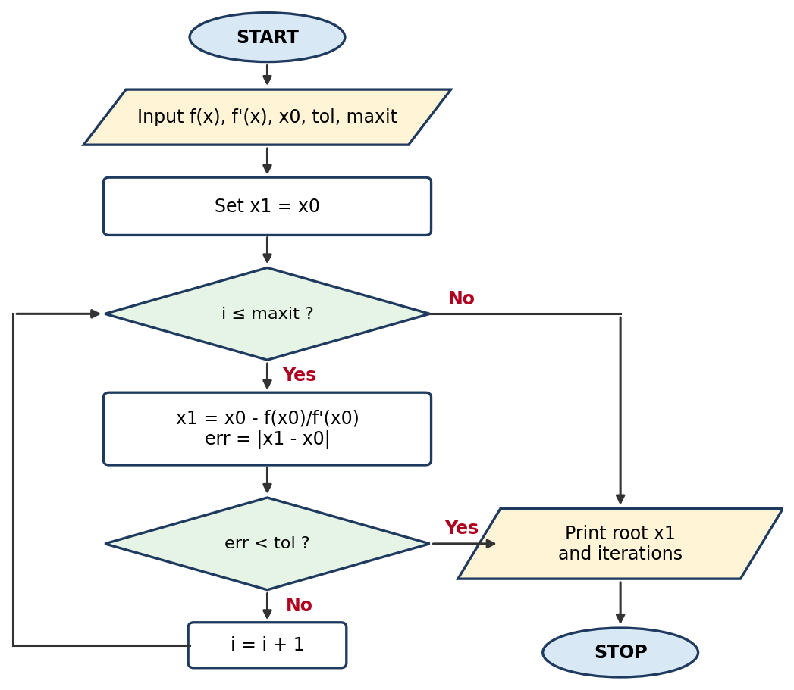
NEWTON-RAPHSON METHOD
Flowchart & pseudo code
FOR LOOP
PSEUDO CODE
START
INPUT f(x), f'(x), x0, tol, maxit
FOR i = 1 TO maxit
x1 = x0 - f(x0) / f'(x0)
err = |x1 - x0|
PRINT i, x1, err
IF err < tol THEN
BREAK
ENDIF
x0 = x1
ENDFOR
PRINT root x1 and iterations
STOP

Slide 7
NEWTON-RAPHSON METHOD
MATLAB code & output
FOR LOOP
MATLAB
OUTPUT
% Newton-Raphson using a FOR loop
clc; clear;
f = @(x) x^3 - 2*x - 5;
df = @(x) 3*x^2 - 2;
x0 = 2; tol = 1e-6; maxit = 50;
for i = 1:maxit
x1 = x0 - f(x0)/df(x0);
err = abs(x1 - x0);
fprintf('Iter %2d: x = %.8f error = %.2e\n', i, x1, err);
if err < tol
break
end
x0 = x1;
end
fprintf('Root = %.6f found in %d iterations\n', x1, i);
Iter 1: x = 2.10000000 error = 1.00e-01
Iter 2: x = 2.09456812 error = 5.43e-03
Iter 3: x = 2.09455148 error = 1.66e-05
Iter 4: x = 2.09455148 error = 1.56e-10
Root = 2.094551 found in 4 iterations

Slide 8
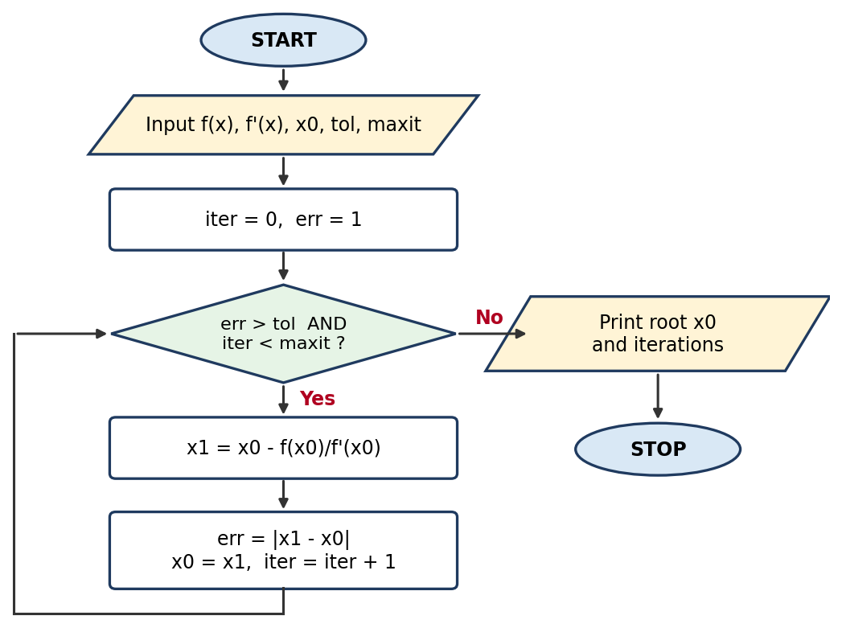
NEWTON-RAPHSON METHOD
Flowchart & pseudo code
WHILE LOOP
PSEUDO CODE
START
INPUT f(x), f'(x), x0, tol, maxit
iter = 0
err = 1
WHILE err > tol AND iter < maxit
x1 = x0 - f(x0) / f'(x0)
err = |x1 - x0|
x0 = x1
iter = iter + 1
PRINT iter, x0, err
ENDWHILE
PRINT root x0 and iterations
STOP

Slide 9
NEWTON-RAPHSON METHOD
MATLAB code & output
WHILE LOOP
MATLAB
OUTPUT
% Newton-Raphson using a WHILE loop
clc; clear;
f = @(x) x^3 - 2*x - 5;
df = @(x) 3*x^2 - 2;
x0 = 2; tol = 1e-6; maxit = 50;
iter = 0; err = 1;
while err > tol && iter < maxit
x1 = x0 - f(x0)/df(x0);
err = abs(x1 - x0);
x0 = x1;
iter = iter + 1;
fprintf('Iter %2d: x = %.8f error = %.2e\n', iter, x0, err);
end
fprintf('Root = %.6f found in %d iterations\n', x0, iter);
Iter 1: x = 2.10000000 error = 1.00e-01
Iter 2: x = 2.09456812 error = 5.43e-03
Iter 3: x = 2.09455148 error = 1.66e-05
Iter 4: x = 2.09455148 error = 1.56e-10
Root = 2.094551 found in 4 iterations

Slide 10
METHOD 2
Secant Method
PROBLEM
Find the real root of
f(x) = cos(x) − x
Guesses x0 = 0, x1 = 1, tolerance 10⁻⁶
FORMULA
x(n+1) = x(n) − f(x(n))·(x(n) − x(n−1))
/ (f(x(n)) − f(x(n−1)))
No derivative needed
0.739085
root found in 5 iterations

Slide 11
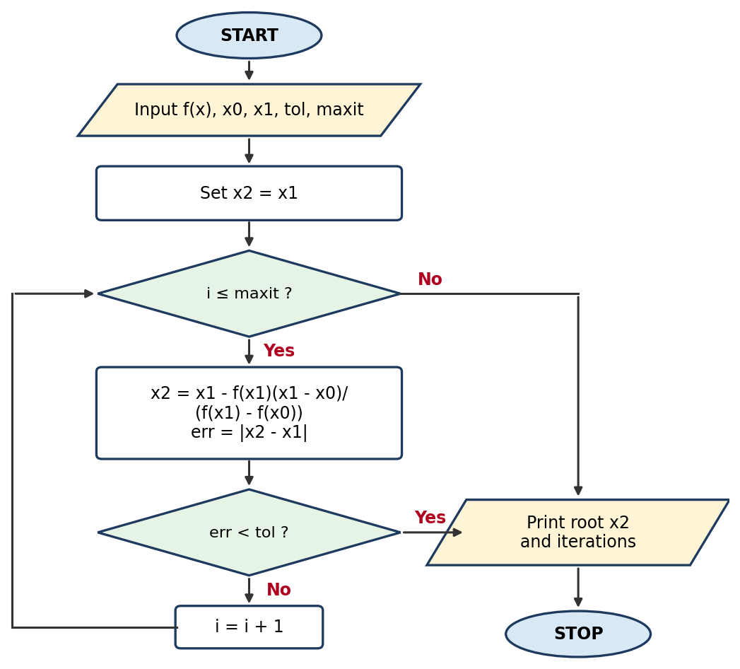
SECANT METHOD
Flowchart & pseudo code
FOR LOOP
PSEUDO CODE
START
INPUT f(x), x0, x1, tol, maxit
FOR i = 1 TO maxit
x2 = x1 - f(x1)*(x1 - x0)
/ (f(x1) - f(x0))
err = |x2 - x1|
PRINT i, x2, err
IF err < tol THEN
BREAK
ENDIF
x0 = x1
x1 = x2
ENDFOR
PRINT root x2 and iterations
STOP

Slide 12
SECANT METHOD
MATLAB code & output
FOR LOOP
MATLAB
OUTPUT
% Secant method using a FOR loop
clc; clear;
f = @(x) cos(x) - x;
x0 = 0; x1 = 1; tol = 1e-6; maxit = 50;
for i = 1:maxit
x2 = x1 - f(x1)*(x1 - x0)/(f(x1) - f(x0));
err = abs(x2 - x1);
fprintf('Iter %2d: x = %.8f error = %.2e\n', i, x2, err);
if err < tol
break
end
x0 = x1;
x1 = x2;
end
fprintf('Root = %.6f found in %d iterations\n', x2, i);
Iter 1: x = 0.68507336 error = 3.15e-01
Iter 2: x = 0.73629900 error = 5.12e-02
Iter 3: x = 0.73911936 error = 2.82e-03
Iter 4: x = 0.73908511 error = 3.42e-05
Iter 5: x = 0.73908513 error = 2.11e-08
Root = 0.739085 found in 5 iterations

Slide 13
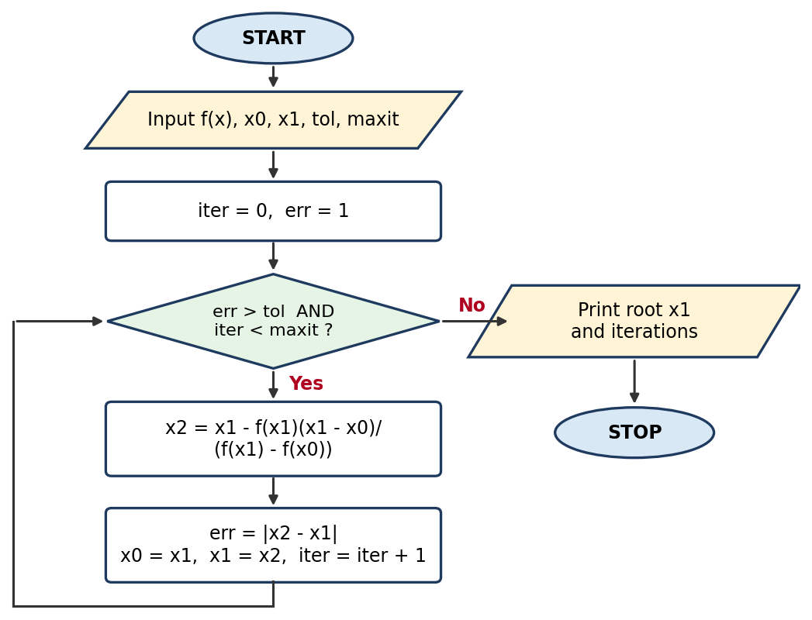
SECANT METHOD
Flowchart & pseudo code
WHILE LOOP
PSEUDO CODE
START
INPUT f(x), x0, x1, tol, maxit
iter = 0
err = 1
WHILE err > tol AND iter < maxit
x2 = x1 - f(x1)*(x1 - x0)
/ (f(x1) - f(x0))
err = |x2 - x1|
x0 = x1
x1 = x2
iter = iter + 1
PRINT iter, x1, err
ENDWHILE
PRINT root x1 and iterations
STOP

Slide 14
SECANT METHOD
MATLAB code & output
WHILE LOOP
MATLAB
OUTPUT
% Secant method using a WHILE loop
clc; clear;
f = @(x) cos(x) - x;
x0 = 0; x1 = 1; tol = 1e-6; maxit = 50;
iter = 0; err = 1;
while err > tol && iter < maxit
x2 = x1 - f(x1)*(x1 - x0)/(f(x1) - f(x0));
err = abs(x2 - x1);
x0 = x1;
x1 = x2;
iter = iter + 1;
fprintf('Iter %2d: x = %.8f error = %.2e\n', iter, x1, err);
end
fprintf('Root = %.6f found in %d iterations\n', x1, iter);
Iter 1: x = 0.68507336 error = 3.15e-01
Iter 2: x = 0.73629900 error = 5.12e-02
Iter 3: x = 0.73911936 error = 2.82e-03
Iter 4: x = 0.73908511 error = 3.42e-05
Iter 5: x = 0.73908513 error = 2.11e-08
Root = 0.739085 found in 5 iterations

Slide 15
METHOD 3
Runge-Kutta (4th Order)
PROBLEM
Solve dy/dx = x + y, y(0) = 1
on 0 ≤ x ≤ 1 with step h = 0.1
Exact: y = 2eˣ − x − 1
FORMULA
y(n+1) = y(n) + (h/6)(k1+2k2+2k3+k4)
k1 = f(x, y)
k2 = f(x+h/2, y+h·k1/2)
k3 = f(x+h/2, y+h·k2/2)
k4 = f(x+h, y+h·k3)
3.436559
y(1) by RK4 (exact 3.436564)

Slide 16
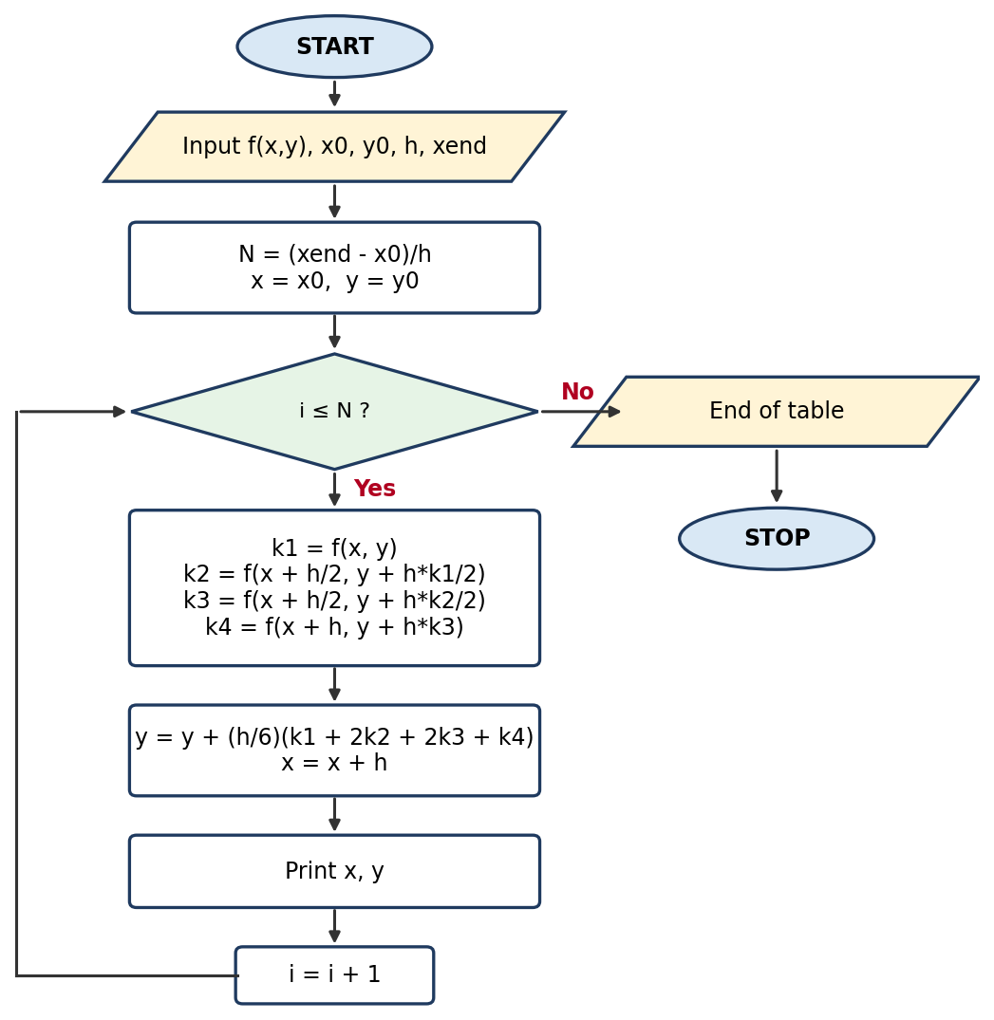
RUNGE-KUTTA METHOD (4TH ORDER)
Flowchart & pseudo code
FOR LOOP
PSEUDO CODE
START
INPUT f(x,y), x0, y0, h, xend
N = (xend - x0) / h
x = x0
y = y0
FOR i = 1 TO N
k1 = f(x, y)
k2 = f(x + h/2, y + h*k1/2)
k3 = f(x + h/2, y + h*k2/2)
k4 = f(x + h, y + h*k3)
y = y + (h/6)*(k1+2*k2+2*k3+k4)
x = x + h
PRINT x, y
ENDFOR
STOP

Slide 17
RUNGE-KUTTA METHOD (4TH ORDER)
MATLAB code & output
FOR LOOP
MATLAB
OUTPUT
% 4th-order Runge-Kutta using a FOR loop
clc; clear;
f = @(x,y) x + y;
x0 = 0; y0 = 1; h = 0.1; xend = 1;
N = round((xend - x0)/h);
x = x0; y = y0;
fprintf('%6s %12s %12s\n','x','y (RK4)','y (exact)');
for i = 1:N
k1 = f(x, y);
k2 = f(x + h/2, y + h*k1/2);
k3 = f(x + h/2, y + h*k2/2);
k4 = f(x + h, y + h*k3);
y = y + (h/6)*(k1 + 2*k2 + 2*k3 + k4);
x = x + h;
fprintf('%6.2f %12.6f %12.6f\n', x, y, 2*exp(x)-x-1);
end
x y (RK4) y (exact)
0.10 1.110342 1.110342
0.20 1.242805 1.242806
0.30 1.399717 1.399718
0.40 1.583648 1.583649
0.50 1.797441 1.797443
0.60 2.044236 2.044238
0.70 2.327503 2.327505
0.80 2.651079 2.651082
0.90 3.019203 3.019206
1.00 3.436559 3.436564

Slide 18
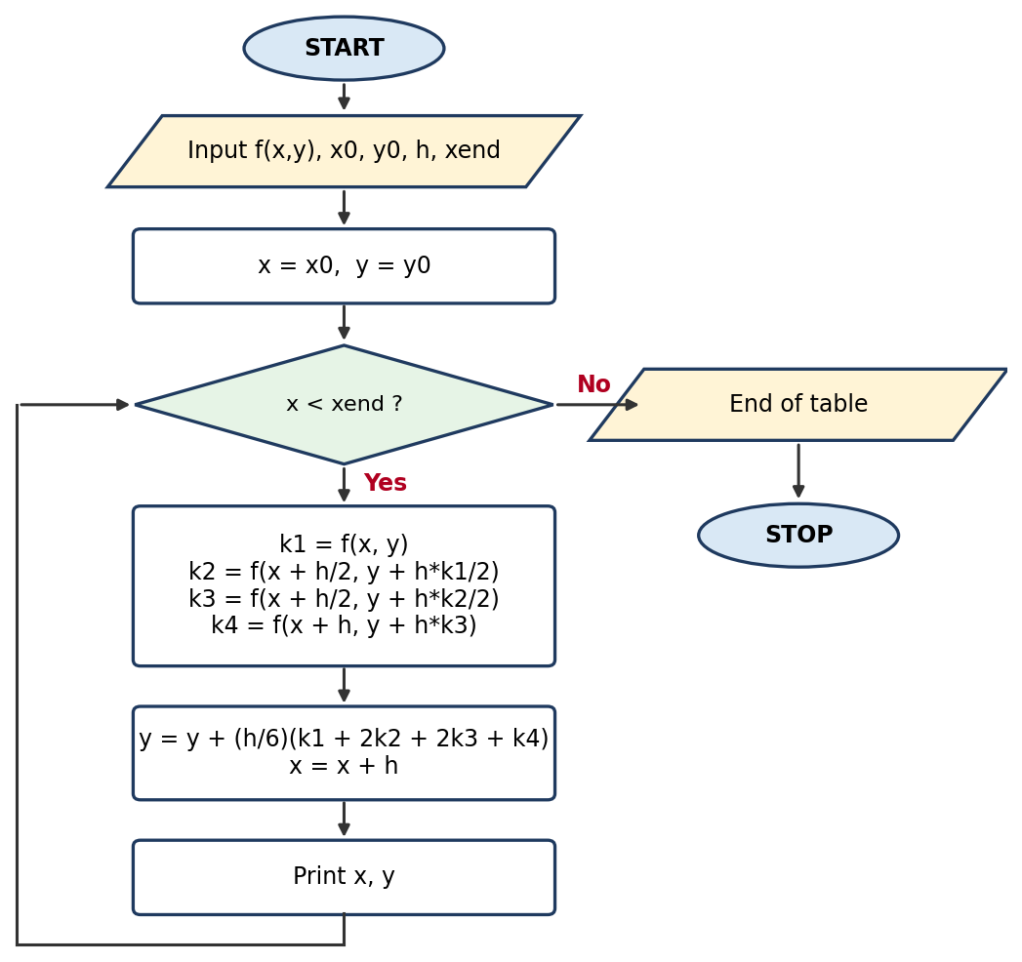
RUNGE-KUTTA METHOD (4TH ORDER)
Flowchart & pseudo code
WHILE LOOP
PSEUDO CODE
START
INPUT f(x,y), x0, y0, h, xend
x = x0
y = y0
WHILE x < xend
k1 = f(x, y)
k2 = f(x + h/2, y + h*k1/2)
k3 = f(x + h/2, y + h*k2/2)
k4 = f(x + h, y + h*k3)
y = y + (h/6)*(k1+2*k2+2*k3+k4)
x = x + h
PRINT x, y
ENDWHILE
STOP

Slide 19
RUNGE-KUTTA METHOD (4TH ORDER)
MATLAB code & output
WHILE LOOP
MATLAB
OUTPUT
% 4th-order Runge-Kutta using a WHILE loop
clc; clear;
f = @(x,y) x + y;
x0 = 0; y0 = 1; h = 0.1; xend = 1;
x = x0; y = y0;
fprintf('%6s %12s %12s\n','x','y (RK4)','y (exact)');
while x < xend - 1e-10
k1 = f(x, y);
k2 = f(x + h/2, y + h*k1/2);
k3 = f(x + h/2, y + h*k2/2);
k4 = f(x + h, y + h*k3);
y = y + (h/6)*(k1 + 2*k2 + 2*k3 + k4);
x = x + h;
fprintf('%6.2f %12.6f %12.6f\n', x, y, 2*exp(x)-x-1);
end
x y (RK4) y (exact)
0.10 1.110342 1.110342
0.20 1.242805 1.242806
0.30 1.399717 1.399718
0.40 1.583648 1.583649
0.50 1.797441 1.797443
0.60 2.044236 2.044238
0.70 2.327503 2.327505
0.80 2.651079 2.651082
0.90 3.019203 3.019206
1.00 3.436559 3.436564

Slide 20
COMPARISON
FOR loop vs WHILE loop
FOR LOOP
WHILE LOOP
Number of passes is fixed by the range 1:maxit
Counter i is handled by MATLAB
Needs break to stop early when err < tol
Best when the step count is known (RK4: N = 10)
Runs until the condition becomes false
You update iter or x yourself
Tolerance and maxit sit in the loop condition
Best when the step count is unknown (root finding)

Slide 21
Results at a glance
Newton-Raphson
Secant
Runge-Kutta (RK4)
2.094551
0.739085
3.436559
4 iterations
5 iterations
y(1); exact 3.436564
The for and while versions of each method give identical results; only the loop control differs.

